Slide 1
PROJECT NAME – Talenttek TEST PLAN
March, 22, 2020
Author:
Javed Chowdry, QA Manger

Slide 2
AGENDA
1
Project Overview
9
Test Exit Criteria
2
System Diagram
10
Deployment Flow
3
Test Scope
11
Performance Test Strategy
4
Test Strategy
12
QA Systems/Tools
5
Test Environment
13
Defect Management
6
Test Timeline
14
QA Reporting
7
Roles and Responsibilities
15
Project Glossary
8
Test Entry Criteria
16
Appendix

Slide 3
1. Project Overview
Enter a high level project description and add a link to the project charter

Slide 4
2. System Diagram
Add a system diagram here and highlight the area under test

Slide 5
3. Test Scope / Out of Scope
Test Scope
Homepage
Sign In page
Order history
Out of scope
Email Confirmation
bla bla
Automation Test

Slide 6
4. Test Strategy
Indicate what type of tests will be performed and how (manual vs automated)
Functional
Integration
Compatibility
End to End
UAT
Regression
Performance
Other

Slide 7
5. Test Environment(s)
Development/Staging - where developers/software engineers writes the code
QA - Where QA test the application
UAT - Where Stakeholders / Product person / QA test the application
Production - where the application is launched to the public

Slide 8
6. Test Timeline
TEST | DESCRIPTION | START DATE | END DATE
Functional Test | QA will test signin/ honmepage/orderhistry | 3/22/2020 | 3/27/2020
Compatibility Test | Chrome/ff/safari/edge | 3/29/2020 | 4/05/2020
End to End Test
Regression Test
Performance Test
TEST DESCRIPTION

Slide 9
7. Roles and Responsibilities
NAME | ROLE | CONTACT | RESPONSIBILITIES
Javed C | QA Manager | ljflasj@gmaicom | Test Plan/Exection
Huma | QA Engineer | lsjflasjf@gmaiol.co | Test Exection
Mhafuj | QA Lead | qgiuolhsiff@abc.com | Reporting/Exection
John A | TEch lead | lsjflasjfls@gmail.com | provide technial solutions/build to QA

Slide 10
8. Test Entry Criteria
Test environment has been identified, refreshed, if needed, and passed the environment smoke test
Test Data has been identified and set up
Promo codes
Test credit cards
Test products
Etc.
Code changes have been checked in and build number has been provided to QA
Test Plan has been developed and communicated to the project team
Etc.

Slide 11
9. Test Exit Criteria
100% high priority functional, compatibility, E2E, UAT tests have been executed
Regression tests passed
Automated regression tests impacted by the new feature(s) have been adjusted and passed
Performance tests have met business requirements
All outstanding defects have been reviewed with Product Owner and prioritized
No outstanding defects priority Very High or Urgent

Slide 12
10. Deployment Flow
Describe deployment flow here.

Slide 13
11. Performance Test Strategy
Indicate if the project requires performance test and attach the performance test strategy.

Slide 14
12. QA Systems/Tools
JIRA – http://
JIRA will be used for defect management
Defect Reports will be generated from Jira
Automation tools
Selenium Webdriver
Backend:
OMS (order management system)

Slide 15
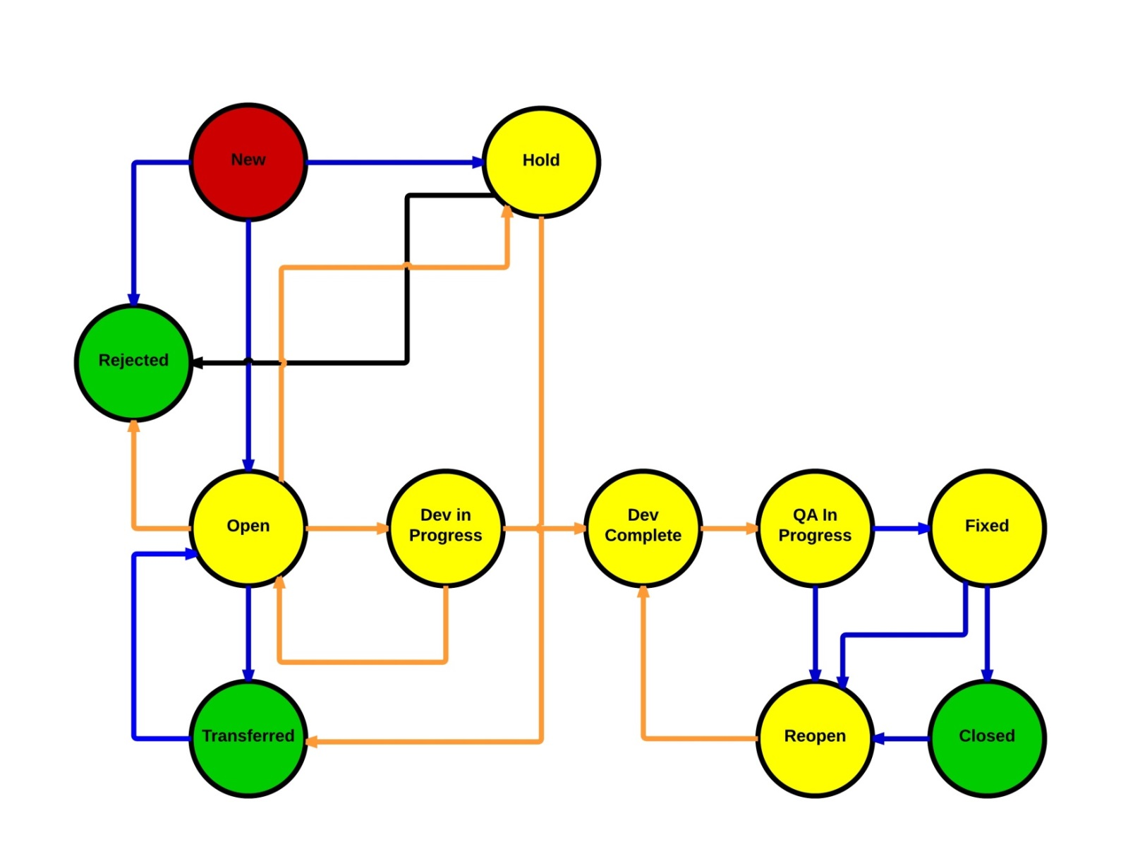
13. Defect Management
Defect Flow

Slide 16
13. Defect Management (continuation)
Defect Priority Classification
PRIORITY | DESCRIPTION
URGENT | Problem prevents use of application, on a critical path to a business process There is no workaround Showstopper/launch gating defect
VERY HIGH | Major functionality malfunction There is no acceptable workaround Showstopper/launch gating defect
HIGH | Major issue with a piece of functionality or application component or usability issue Has acceptable but difficult workaround
MEDIUM | Minor functionality malfunction Problem impairs but does not prevent use of an application Has acceptable and easy workaround
LOW | Minor loss or cosmetic issue

Slide 17
14. Reporting
Weekly Test Status Report by QA (every Thursday)
Team Daily Standups
Daily Defect Triage
Etc.

Slide 18
15. Project Glossary
Include project-specific terms and acronyms
Add a link to generic QA glossary

Slide 19
16. Appendix
Supporting documents

